Slide 1
Halloween Assignment
Notes:
Title Slide

Slide 2
Halloween Assignment

Slide 3
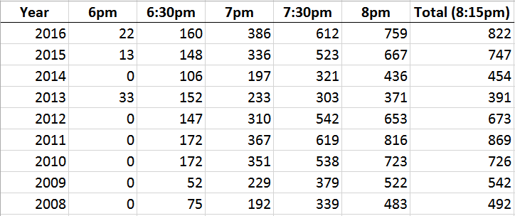
Halloween Assignment
Create a visualization using the dataset provided

Slide 4
How to Approach
Decide on a story to tell
Append some sort of external data
Prepare the Data Visualization

Slide 5
How to Approach
Determine a story or goal for the visualization. Examples: Homeowner dashboard summarizing Halloween Forecast future trick-or-treaters or estimate future candy need Explore variation of the number of trick-or-treaters year by year
This is a very simple data set. There are only a few years of data broken down into 4 half-hour time blocks with cumulative totals. Think broadly about the data. Examples: The data is time series data – any additional choices? What comparisons can you make? What table calculations can be made? What additional data can be appended from other sources to help tell the story or complete an analysis? NOTE - be very careful because there are many pitfalls at this step.

Slide 6
How to Approach
Additional Notes: Numbers in data file for Excel are cumulative. Numbers in data file for Tableau have been unpivoted and are not cumulative. City: Hamilton The date for trick or treating has always been on 10/31 (some neighborhoods change the night for trick or treating) The type of candy did not vary year by year. It is always a general mix of candy Official trick or treat hours are from 6pm-8pm, but at 8pm I do not kick the children off my porch and say "no candy for you". These "stragglers" trickle down and by 8:15pm there are no more. In 2013 there were a number of them that showed up early.

Slide 7
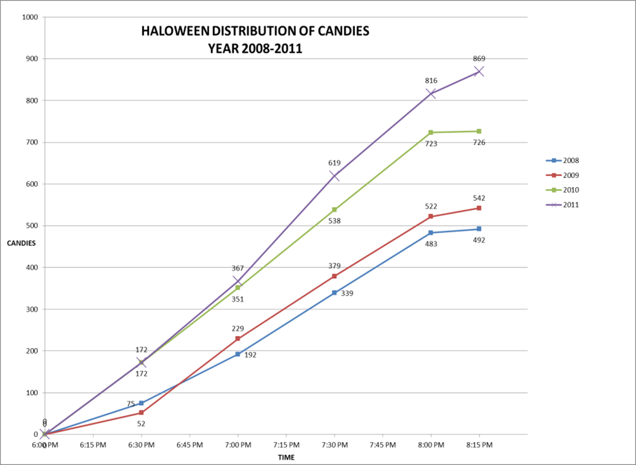
Example of what NOT to do…

Slide 8
Dataset and More Information
Find the data set and additional information online
This includes:
The Excel Data File
Tableau Data File
Description
Additional Information

Slide 9
What to submit
Put your visual into a one or two page PPT slide…if your insights require another page that is fine
Add any notes/comments if needed

